Slide 1

Chapter 2 – Stream Ciphers
Dr. Mostafiz
Professor
Department of Computer Science and Engineering
Jahangirnagar University

Slide 2
Content of this Chapter
Intro to stream ciphers
Shift Register Based Stream Cipher
Linear feedback shift registers (LFSRs)

Slide 3
Stream Ciphers in the Field of Cryptology
Cryptology
Cryptography
Cryptanalysis
Symmetric Ciphers
Asymmetric Ciphers
Protocols
Block Ciphers
Stream Ciphers
Stream Ciphers were invented in 1917 by Gilbert Vernam
Notes:
Cryptology is the mathematics, such as number theory and the application of formulas and algorithms, that underpin cryptography and cryptanalysis.
Cryptography is a method of protecting information and communications through the use of codes, so that only those...
Cryptanalysis is the study of ciphertext, ciphers and cryptosystems with the aim of understanding how they work

Slide 4
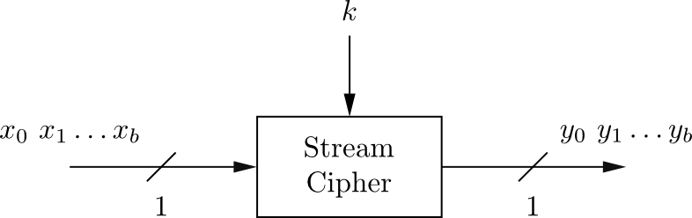
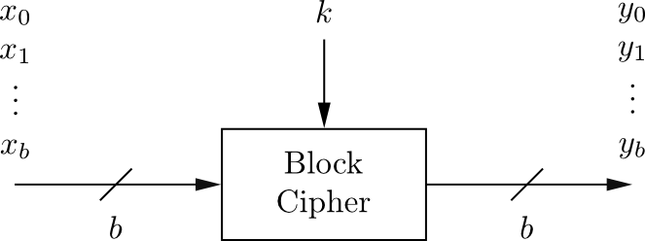
Stream Cipher vs. Block Cipher
Stream Ciphers
Encrypt bits individually
Usually small and fast → common in embedded devices (e.g., A5/1 for GSM phones for Voice encryption)
Block Ciphers:
Always encrypt a full block (several bits)
Are common for Internet applications
Notes:
Stream ciphers encrypt bits individually. This is achieved by adding a bit from a key stream to a plaintext bit. There are synchronous stream ciphers where the key stream depends only on the key.
Block ciphers encrypt an entire block of plaintext bits at a time with the same key. This means that the encryption of any plaintext bit in a given block depends on every other plaintext bit in the same block. In practice, the vast majority of block ciphers either have a block length of 128 bits (16 bytes) such as the advanced encryption standard (AES), or a block length of 64 bits (8 bytes) such as the data encryption standard (DES) or triple DES (3DES) algorithm. All of these ciphers are introduced in later chapters.
1. In practice, in particular for encrypting computer communication on the Internet, block ciphers are used more often than stream ciphers. 2. Because stream ciphers tend to be small and fast, they are particularly relevant for applications with little computational resources, e.g., for cell phones or other small embedded devices. A prominent example for a stream cipher is the A5/1 cipher, which is part of the GSM mobile phone standard and is used for voice encryption. However, stream ciphers are sometimes also used for encrypting Internet traffic, especially the stream cipher RC4. 3. Traditionally, it was assumed that stream ciphers tended to encrypt more efficiently than block ciphers. Efficient for software-optimized stream ciphers means that they need fewer processor instructions (or processor cycles) to encrypt one bit of plaintext. For hardware-optimized stream ciphers, efficient means they need fewer gates (or smaller chip area) than a block cipher for encrypting at the same data rate. However, modern block ciphers such as AES are also very efficient in software. Moreover, for hardware, there are also highly efficient block ciphers, such as PRESENT, which are as efficient as very compact stream ciphers.

Slide 5
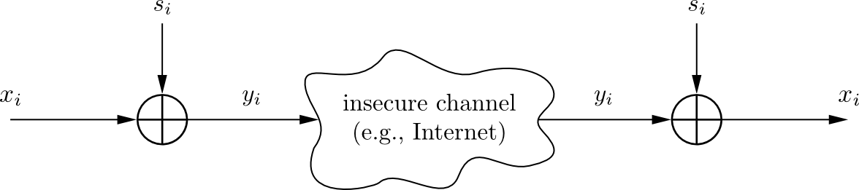
Encryption and Decryption with Stream Ciphers
Plaintext x_{i}, ciphertext y_{i} and key stream s_{i} consist of individual bits
Encryption and decryption are simple additions modulo 2 (aka XOR)
Encryption and decryption are the same functions
Encryption: y_{i} = e_{si}(x_{i} ) = x_{i} + s_{i} mod 2 x_{i} , y_{i} , s_{i} ∈ {0,1}
Decryption: x_{i} = d_{si}(y_{i} ) = y_{i} + s_{i} mod 2

Slide 6
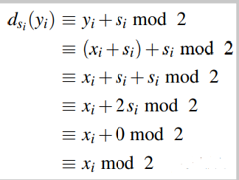
Why Are Encryption and Decryption the Same Function?
The reason for the similarity of the encryption and decryption function can easily be shown.
We must prove that the decryption function actually produces the plaintext bit xi again. We know that ciphertext bit y_{i} was computed using the encryption function y_{i} ≡ x_{i} +s_{i} mod 2.
If s_{i} has the value 0,
2s_{i} = 2 · 0 ≡ 0 mod 2.
If s_{i} = 1, we have
2s_{i} = 2 · 1 = 2 ≡ 0 mod 2.
Notes:
The trick here is that the expression (2si mod 2) has always the value zero since 2 ≡ 0 mod 2. Another way of understanding this is as follows: If si has either the value 0, in which case 2si = 2 · 0 ≡ 0 mod 2. If si = 1, we have 2si = 2 · 1 = 2 ≡ 0 mod 2.

Slide 7
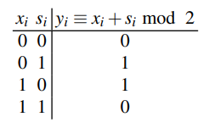
Why is Modulo 2 Addition a Good Encryption Function?
Modulo 2 addition is equivalent to XOR operation
For perfectly random key stream s_{i} , each ciphertext output bit has a 50% chance to be 0 or 1
→ Good statistic property for ciphertext
Inverting XOR is simple, since it is the same XOR operation
Truth table of the XOR operation
x_{i} | s_{i} | y_{i}
0 | 0 | 0
0 | 1 | 1
1 | 0 | 1
1 | 1 | 0

Slide 8
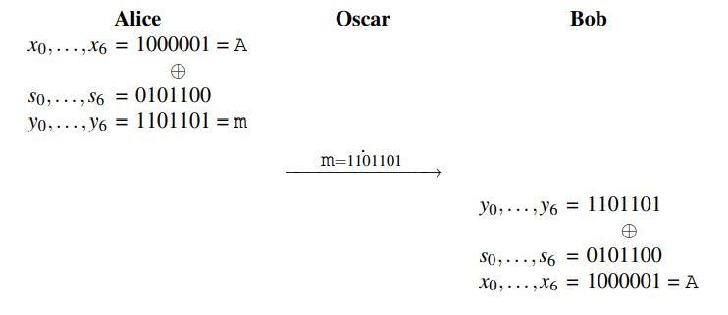
Alice wants to encrypt the letter A, where the letter is given in ASCII code. The ASCII value for A is 65₁₀ = 1000001₂. Let’s furthermore assume that the first key stream bits are (s₀,...,s₆) = 0101100.

Slide 9
Content of this Chapter
Intro to stream ciphers
Shift Register Based Stream Cipher
Linear feedback shift registers (LFSRs)
Notes:
An elegant way of realizing long pseudorandom sequences is to use linear feedback shift registers (LFSRs). LFSRs are easily implemented in hardware and many, but certainly not all, stream ciphers make use of LFSRs. A prominent example is the A5/1 cipher, which is standardized for voice encryption in GSM. As we will see, even though a plain LFSR produces a sequence with good statistical properties, it is cryptographically weak. However, combinations of LFSRs, such as A5/1 or the cipher Trivium, can make secure stream ciphers. It should be stressed that there are many ways for constructing stream ciphers. This section only introduces one of several popular approaches.
(Do from BooK)

Slide 10
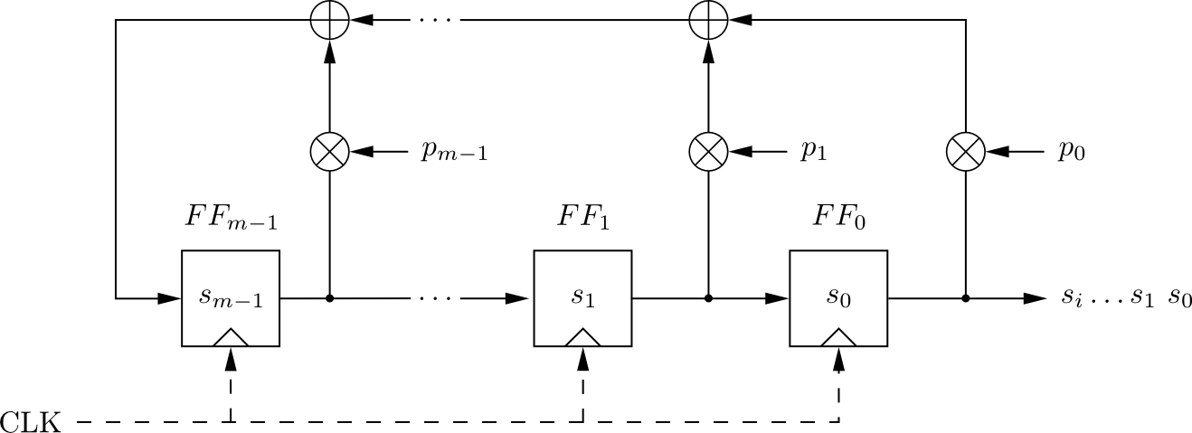
Linear Feedback Shift Registers (LFSRs)
Concatenated flip-flops (FF), i.e., a shift register together with a feedback path
Feedback computes fresh input by XOR of certain state bits
Degree m given by number of storage elements
If p_{i} = 1, the feedback connection is present (“closed switch), otherwise there is not feedback from this flip-flop (“open switch”)
Output sequence repeats periodically
Maximum output length: 2^{m}-1
Notes:
An LFSR consists of clocked storage elements (flip-flops) and a feedback path. The number of storage elements gives us the degree of the LFSR. In other words, an LFSR with m flip-flops is said to be of degree m. The feedback network computes the input for the last flip-flop as XOR-sum of certain flip-flops in the shift register.

Slide 11
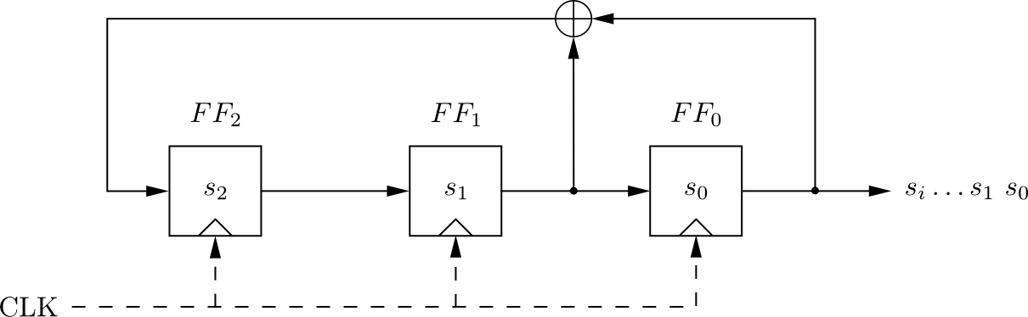
Linear Feedback Shift Registers (LFSRs): Example with m=3
clk | FF₂ | FF₁ | FF₀=s_{i}
0 | 1 | 0 | 0
1 | 0 | 1 | 0
2 | 1 | 0 | 1
3 | 1 | 1 | 0
4 | 1 | 1 | 1
5 | 0 | 1 | 1
6 | 0 | 0 | 1
7 | 1 | 0 | 0
8 | 0 | 1 | 0
LFSR output described by recursive equation:
Maximum output length (of 2³-1=7) achieved only for certain feedback configurations, .e.g., the one shown here.
Notes:
Simple LFSR We consider an LFSR of degree m = 3 with flip-flops FF2, FF1, FF0, and a feedback path as shown in Fig. 2.6. The internal state bits are denoted by si and are shifted by one to the right with each clock tick. The rightmost state bit is also the current output bit. The leftmost state bit is computed in the feedback path, which is the XOR sum of some of the flip-flop values in the previous clock period. Since the XOR is a linear operation, such circuits are called linear feedback shift registers. If we assume an initial state of (s2 = 1,s1 = 0,s0 = 0), Table 2.2 gives the complete sequence of states of the LFSR. Note that the rightmost column is the output of the LFSR. One can see from this example that the LFSR

Slide 12
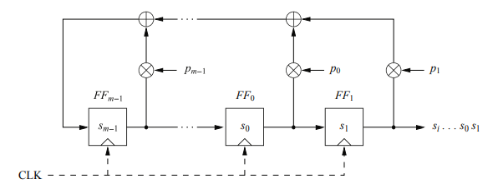
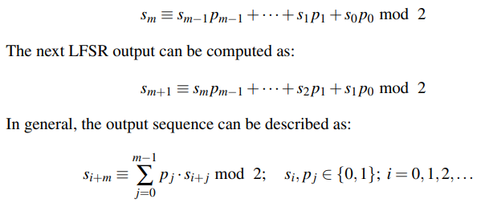
A Mathematical Description of LFSRs
The general form of an LFSR of degree m
It shows m flip-flops and m possible feedback locations, all combined by the XOR operation. Whether a feedback path is active or not, is defined by the feedback coefficient p₀, p₁,..., p_{m−1}:
If p_{i} = 1 (closed switch), the feedback is active.
If pi = 0 (open switch), the corresponding flip-flop output is not used for the feedback.
Let’s assume the LFSR is initially loaded with the values s₀,...,s_{m−1}. The next output bit of the LFSR s_{m}, which is also the input to the leftmost flip-flop, can be computed by the XOR-sum of the products of flip-flop outputs and corresponding feedback coefficient:
Notes:
The general form of an LFSR of degree m is shown in Fig. 2.7. It shows m flip-flops and m possible feedback locations, all combined by the XOR operation. Whether a feedback path is active or not, is defined by the feedback coefficient p0, p1,..., pm−1: If pi = 1 (closed switch), the feedback is active. If pi = 0 (open switch), the corresponding flip-flop output is not used for the feedback. With this notation, we obtain an elegant mathematical description for the feedback path. If we multiply the output of flip-flop i by its coefficient pi, the result is either the output value if pi = 1, which corresponds to a closed switch, or the value zero if pi = 0, which corresponds to an open switch. The values of the feedback coefficients are crucial for the output sequence produced by the LFSR.
Clearly, the output values are given through a combination of some previous output values. LFSRs are sometimes referred to as linear recurrences.
Due to the finite number of recurring states, the output sequence of an LFSR repeats periodically. This was also illustrated in Example 2.3. Moreover, an LFSR can produce output sequences of different lengths, depending on the feedback coefficients. The following theorem gives us the maximum length of an LFSR as function of its degree.
It is easy to show that this theorem holds. The state of an LFSR is uniquely determined by the m internal register bits. Given a certain state, the LFSR deterministically assumes its next state. Because of this, as soon as an LFSR assumes a previous state, it starts to repeat. Since an m-bit state vector can only assume 2m −1 nonzero states, the maximum sequence length before repetition is 2m −1. Note that the allzero state must be excluded. If an LFSR assumes this state, it will get “stuck” in it, i.e., it will never be able to leave it again. Note that only certain configurations (p0,..., pm−1) yield maximum length LFSRs. We give a small example for this below

Slide 13
Example 2.4. LFSR with maximum-length output sequence
Given an LFSR of degree m = 4 and the feedback path (p3 = 0, p2 = 0, p1 = 1, p0 = 1), the output sequence of the LFSR has a period of 2^{m} − 1 = 15, i.e., it is a maximum-length LFSR.
Example 2.5. LFSR with non-maximum output sequence
Given an LFSR of degree m = 4 and (p3 = 1, p2 = 1, p1 = 1, p0 = 1), then the output sequence has period of 5; therefore, it is not a maximum-length LFSR.

Slide 14

Feedback Coefficient Vector
LFSRs are often specified by polynomials using the following notation: An LFSR with a feedback coefficient vector (p_{m−1},..., p₁, p₀) is represented by the polynomial
For instance, the LFSR from the example above with coefficients (p₃ = 0, p₂ = 0, p₁ = 1, p₀ = 1) can alternatively be specified by the polynomial x⁴ + x + 1.
This seemingly odd notation as a polynomial has several advantages.
For instance, maximum-length LFSRs have what is called primitive polynomials. Primitive polynomials are a special type of irreducible polynomial.
Irreducible polynomials are roughly comparable with prime numbers, i.e., their only factors are 1 and the polynomial itself.
Primitive polynomials can relatively easily be computed. Hence, maximum-length LFSRs can easily be found.
The next slide shows one primitive polynomial for every value of m in the range from m = 2,3,...,128.
As an exam the notation (0,2,5) refers to the polynomial 1+x² +x⁵.
Notes:
For instance, the LFSR from the example above with coefficients (p3 = 0, p2 = 0, p1 = 1, p0 = 1) can alternatively be specified by the polynomial x4 + x + 1. This seemingly odd notation as a polynomial has several advantages. For instance, maximum-length LFSRs have what is called primitive polynomials. Primitive polynomials are a special type of irreducible polynomials. Irreducible polynomials are roughly comparable with prime numbers, i.e., their only factors are 1 and the polynomial itself. Primitive polynomials can relatively easily be computed. Hence, maximum-length LFSRs can easily be found. Table 2.3 shows one primitive polynomial for every value of m in the range from m = 2,3,...,128. As an example
the notation (0,2,5) refers to the polynomial 1+x2 +x5. Note that there are many primitive polynomials for every given degree m. For instance, there exist 69,273,666 different primitive polynomials of degree m = 31.

Slide 15
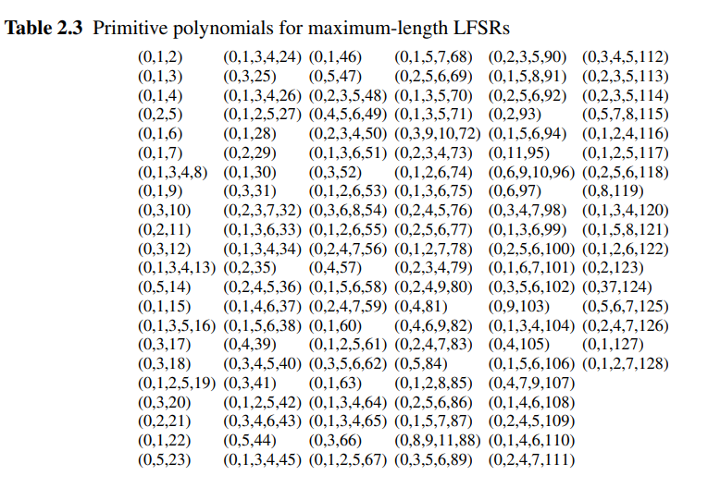
Primitive polynomial

Slide 16
Security of LFSRs
LFSRs typically described by polynomials:
Single LFSRs generate highly predictable output
If 2m output bits of an LFSR of degree m are known, the feedback coefficients p_{i} of the LFSR can be found by solving a system of linear equations
Notes:
As indicated by its name, LFSRs are linear. Linear systems are governed by linear relationships between their inputs and outputs. Since linear dependencies can relatively easily be analyzed, this can be a major advantage, e.g., in communication systems. However, a cryptosystem where the key bits only occur in linear relationships makes a highly insecure cipher. We will now investigate how the linear behavior of a LFSR leads to a powerful attack. If we use an LFSR as a stream cipher, the secret key k is the feedback coefficient vector (pm−1,..., p1, p0).
An attack is possible if the attacker Oscar knows some plaintext and the corresponding ciphertext. We further assume that Oscar knows the degree m of the LFSR. The attack is so efficient that he can easily try a large number of possible m values, so that this assumption is not a major restriction.
Let the known plaintext be given by x0,x1,...,x2m−1 and the corresponding ciphertext by y0,y1,...,y2m−1. With these 2m pairs of plaintext and ciphertext bits, Oscar reconstructs the first 2m key stream bits: si ≡ xi +yi mod 2; i = 0,1,...,2m−1. The goal is now to find the key which is given by the feedback coefficients pi

Slide 17

Known-Plaintext Attack Against Single LFSRs
If we use an LFSR as a stream cipher, the secret key k is the feedback coefficient vector (p_{m−1},..., p₁, p₀).
An attack is possible if the attacker Oscar knows
Some plaintext at least 2m and the corresponding ciphertext.
We further assume that Oscar knows the degree m of the LFSR.
Let the known plaintext be given by x₀,x₁,...,x_{2m−1} and the corresponding ciphertext by y₀,y₁,...,y_{2m−1}. With these 2m pairs of plaintext and ciphertext bits,
Oscar reconstructs the first 2m key stream bits:

Slide 18
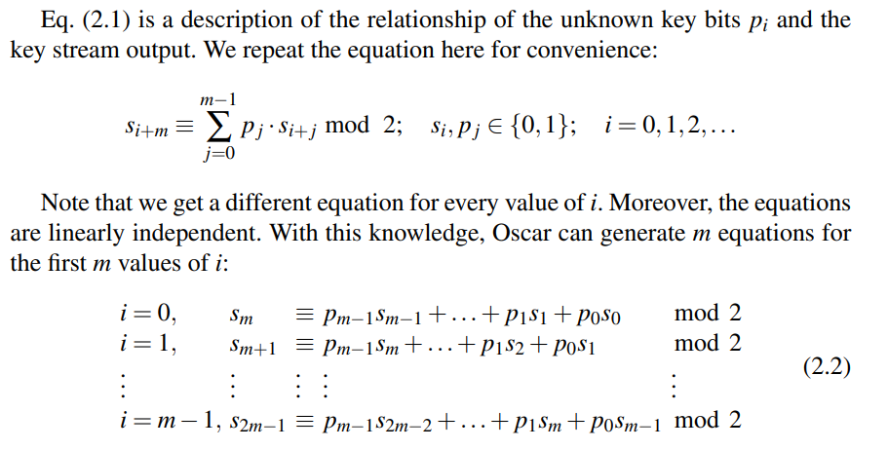
Known-Plaintext Attack Against Single LFSRs (cont…)
Goal:
To find the key which is given by the feedback coefficients p_{i}
extremely insecure!
Notes:
He has now m linear equations in m unknowns p0, p1,..., pm−1. This system can easily be solved by Oscar using Gaussian elimination, matrix inversion or any other algorithm for solving systems of linear equations.
Even for large values of m, this can be done easily with a standard PC. This situation has major consequences: as soon as Oscar knows 2m output bits of an LFSR of degree m, the p_{i} coefficients can exactly be constructed by merely solving a system of linear equations. Once he has computed these feedback coefficients, he can “build” the LFSR and load it with any m consecutive output bits that he already knows. Oscar can now clock the LFSR and produce the entire output sequence. Because of this powerful attack, LFSRs by themselves are extremely insecure! They are a good example of a PRNG with good statistical properties but with terrible cryptographical ones. Nevertheless, all is not lost. There are many stream ciphers which use combinations of several LFSRs to build strong cryptosystems. The cipher Trivium in the next section is an example

Slide 19
Exercise
Conduct a known-plaintext attack on an LFSR-based stream cipher. We know that the plaintext sent was:
1001 0010 0110 1101 1001 0010 0110
By tapping the channel we observe the following stream:
1011 1100 0011 0001 0010 1011 0001
What is the degree mm of the key stream generator?
What is the initialization vector?
Determine the feedback coefficients of the LFSR.
Draw a circuit diagram and verify the output sequence of the LFSR

Slide 20
Solution
1. By XORing the ciphertext stream with the keystream, we get the following:
0010 1110 0101 1100 1011 1001 0111
If we arrange this into 7-bit blocks then we can easily see that the key repeats every 7 bits. The period of the LFSR is therefore 7.
0010111 0010111 0010111 0010111
Since the period of an LFSR (with primitive polynomial) is defined by p=2^{m}−1, we can rearrange this to m=log₂(p+1) = log₂(7+1) =3
Therefore the degree of the LFSR must be 3.
2. The first m bits of the keystream are (s₀=0,s₁=0,s₂=1), so therefore the initialization vector must be:
(s₂=1,s₁=0,s₀=0)

Slide 21
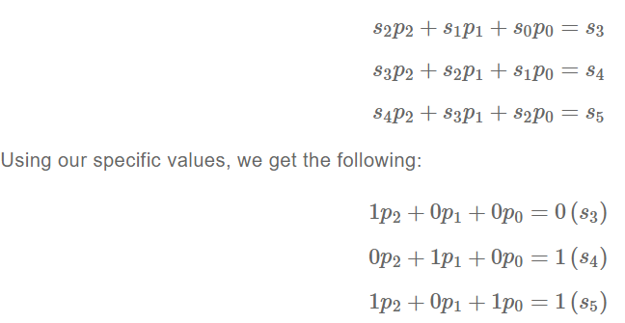
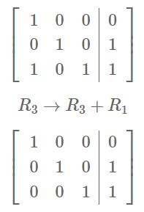
Solution
3. Using the following 3 bits of the keystream (since we require 2m key bits for an attack), we can construct a set of simultaneous equations where the unknowns are the feedback coefficients that produced those next three values:
This can be converted into an augmented matrix and solved via Gauss-Jordan Elimination:

Slide 22
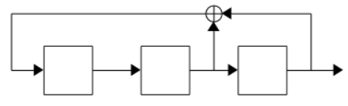
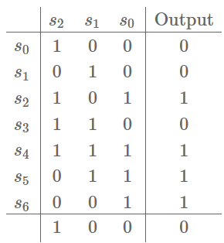
Solution
The matrix is now in reduced row echelon form, which allows the values of the unknowns to be read directly from the matrix. The feedback coefficients of the LFSR are (p₀=1,p₁=1,p₂=0), which is represented graphically as follows:
To double-check that our solution is correct, we can run the reconstructed LFSR ourselves to be sure that it produces the same keystream:

Slide 23
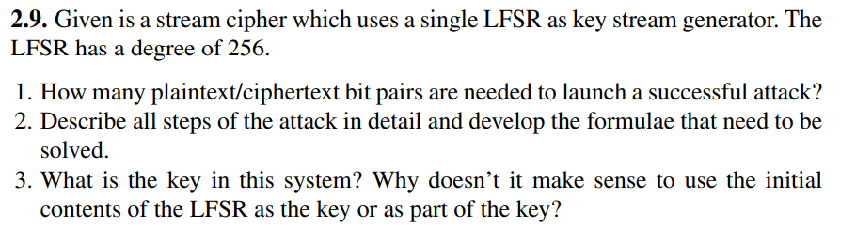
Exercise

Slide 24
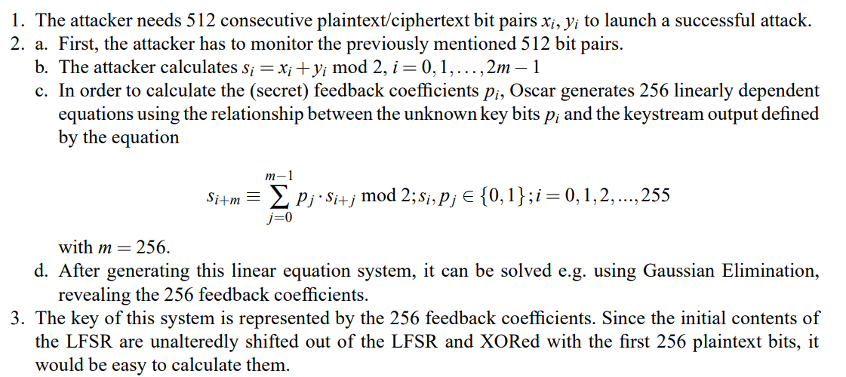
Solution

Slide 25
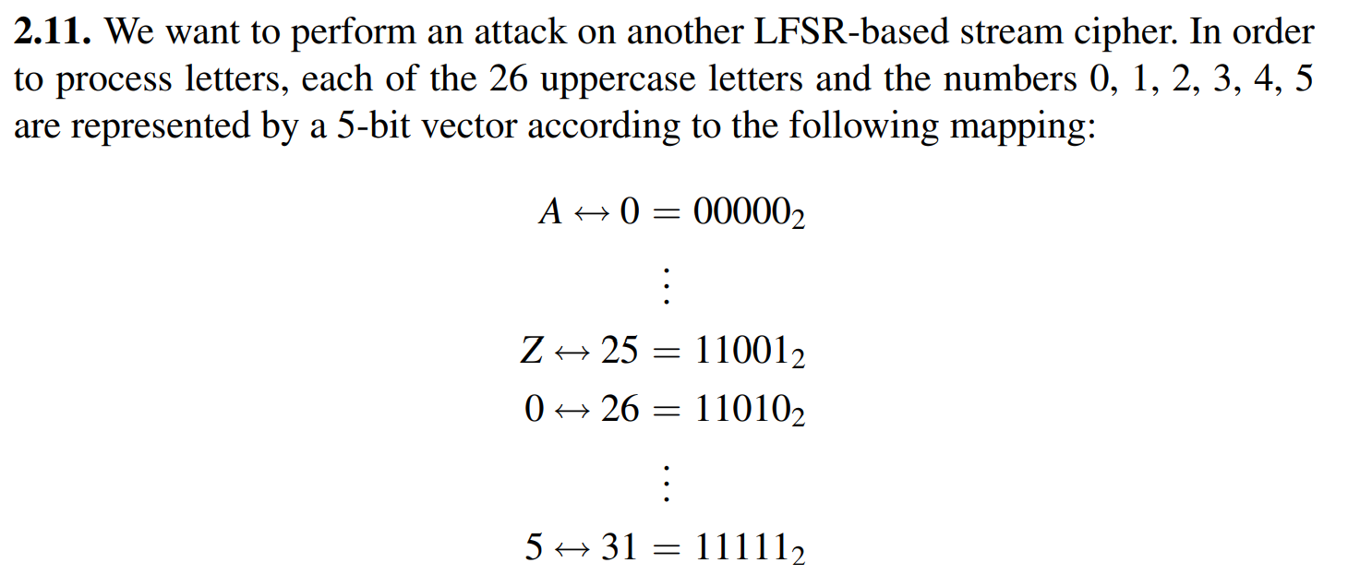
Homework

Slide 26
